Slide 1
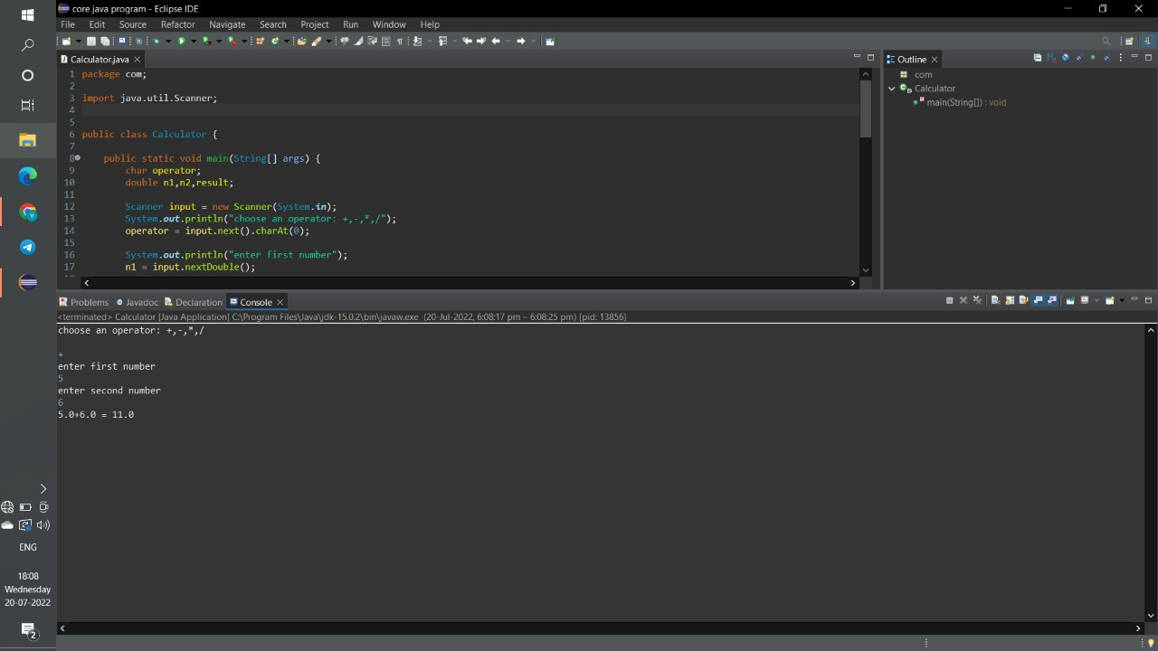
Arithmetic calculator screenshots

Slide 2
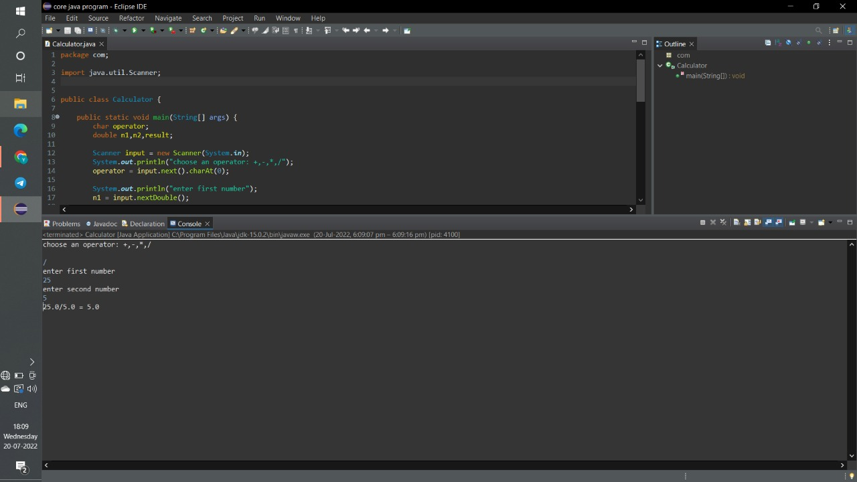

Slide 3


Slide 4
